Slide 1
Medical CT Object Tracking Projects
COMPUTER vision

Slide 2
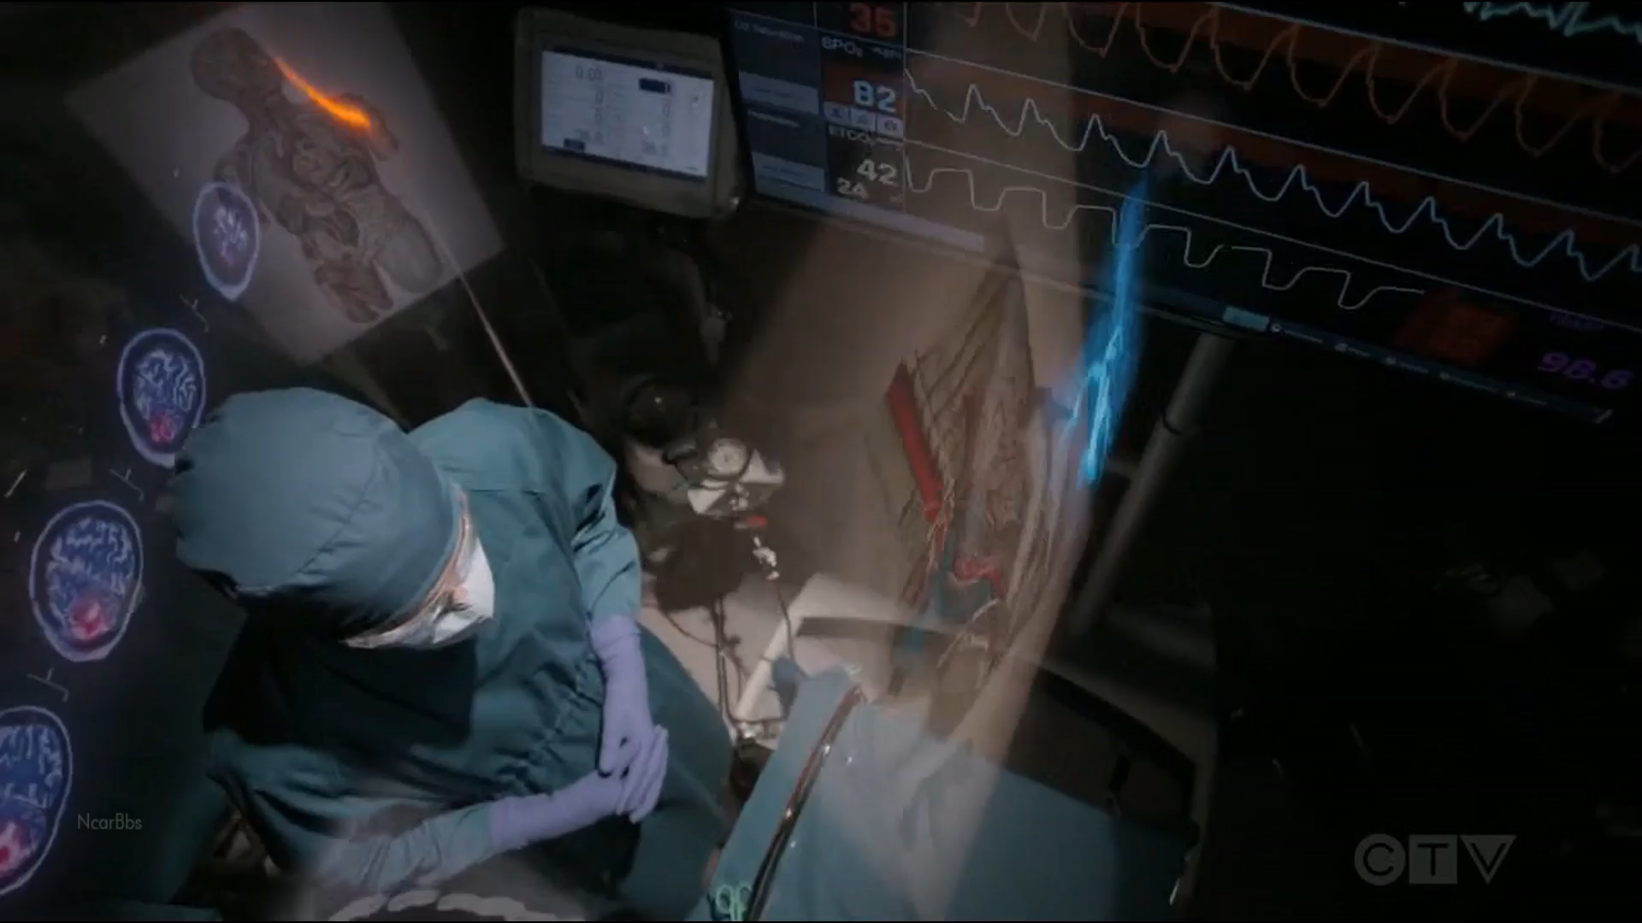
Introduction
1

Slide 3
Introduction
2
Developed software application using specific object tracking in Fiji Image that allows surgeons to easily create the vessels and the calcifications data on medical CT.
Integrated OpenCV with Python that allow surgeons to effortlessly judge the operation location and the size of the vessel calcifications needed to remove in beginning stage.

Slide 4
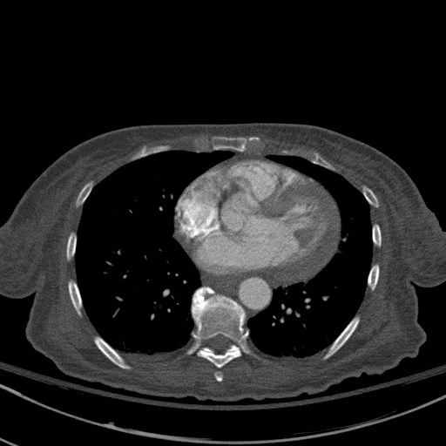
Introduction
3

Slide 5
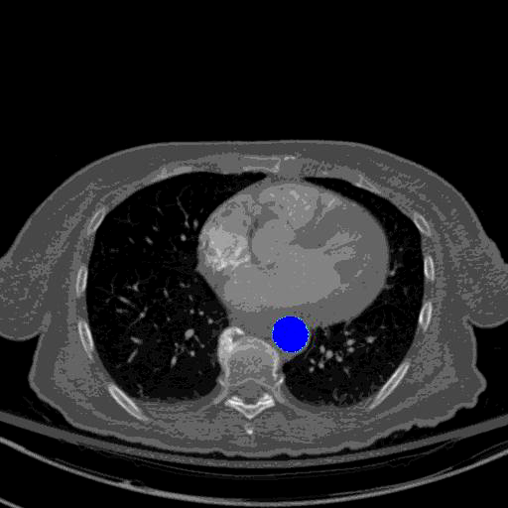
Result
4

Slide 6
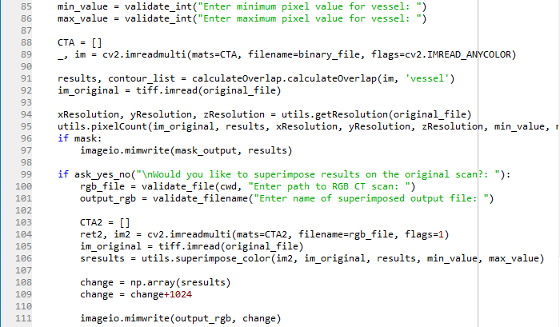
Screenshot
5

Slide 7
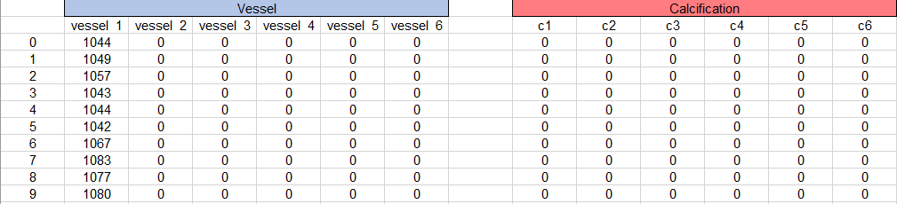
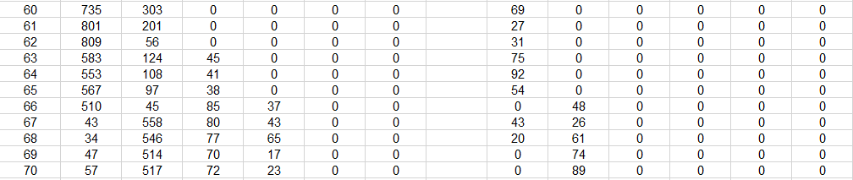
Summary
6
... …

Slide 8
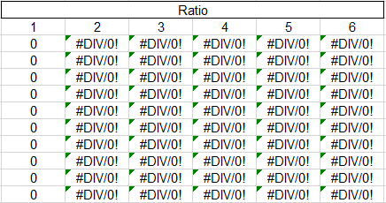
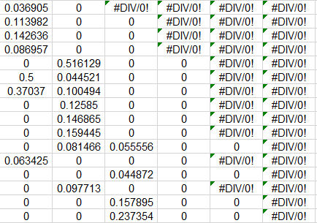
Summary
7
... …

Slide 9
Summary
8
Item | Results
Volume of Vessel Detected (mm^3) | 109372.29
Volume of Calcification Detected (mm^3) | 9866.06
Ratio of Calcification: Vessel | 8.27%
Slice with Max Blockage | 399
Number of vessel pixels | 137408
Number of calcification pixels | 12359
Number of lesions | 451

Slide 10
References
9
[1] Internet Resources, https://docs.opencv.org/master/d9/df8/tutorial_root.html, etc.
[2] F. Milletari, N. Navab, et al., V-net: Fully Convolutional Neural Networks for Volumetric Medical Image Segmentation, Proceedings of Fourth International Conference on 3D Vison, pp 565-571, 2017.
[3] S. Pereira, et al., Brain Tumor Segmentation using Convolutional Neural Networks in MRI Images, IEEE Transactions on Medical Imaging, Vol. 35, 2016.
…….

Slide 11
Thank You

